Slide 1
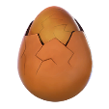





DRAGONMITE

Slide 2
OVERVIEW
Overview
Genre: Puzzle.
Camera: 2D – Fixed camera.
Game session: Short (5-10 mins)
Target platform: Android, iOS (Compatible with as many firmwares as possible)
Target user: All ages
Theme: Cartoon, Fantasy.
Concept
A puzzle battle that inspired by Dynomite!, Bubble Bash, Puzzle Bobble & Tetris 99.

Slide 3
OVERVIEW
How does the game derive inspiration from Puzzle Bubble?
Dragonmite is an action puzzle game.
In Multiplayer mode, players will try to break multiple objects in order to slow down defeat and punish opponents.
How does the game derive inspiration from Dynomite?
Dragonmite uses eggs as objects to play.
Users interact with dragons similar to dinosaurs.
How does the game derive inspiration from Tetris 99?
Given enough time, there will be more player playing at the same time in a battle royale mode.

Slide 4
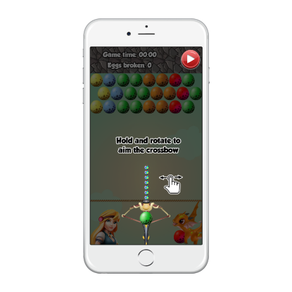
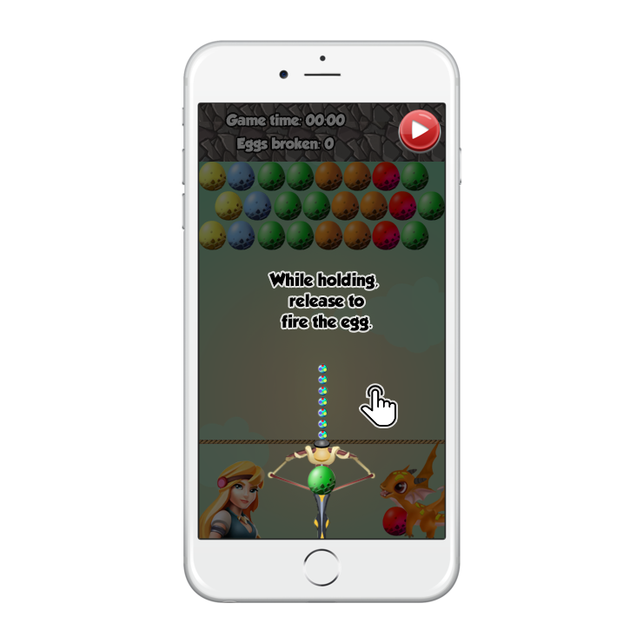
OVERVIEW
Control
Hold to aim the launcher left or right.
While holding, release to fire.

Slide 5
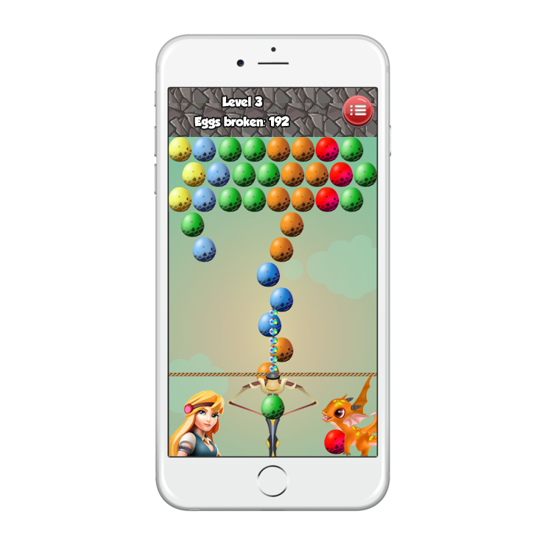
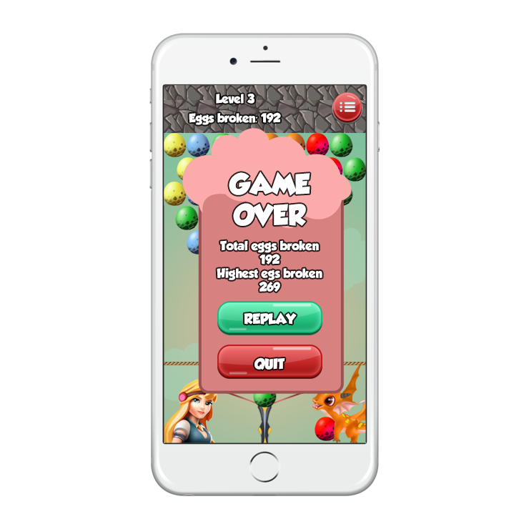
OVERVIEW
Camera
Fixed 2D camera, rectangle field.
Win – lose condition
Win condition: remain playing in an endless match. Reach highest eggs broken count.
Lose condition: Any egg crossing the bottom deadline.

Slide 6
GAMEPLAY
Gameplay objective
General: The objective of the game is to clear all the eggs from the field without any egg crossing the bottom line.
Single: Keep clearing the eggs to gain the highest eggs broken count in endless mode.
Multiplayer: By clearing the eggs, player will delay their inevitable defeat and make other player reach their deadline faster.
Game mode
Single: Break eggs to accumulate the highest eggs broken count in an endless mode.
Multiplayer Classic: Break eggs to send trash attack to enemy field.

Slide 7
GAMEPLAY
Game subject
(Ballista)
The ballista rotate left or right on x axis based on player input
The max angle is -X°/X° (should be between -170/170)
The ballista can’t rotate backward.
Eggs will fire automatically if the player remains idle.

Slide 8
GAMEPLAY
Game subject (Egg)
The fired eggs travel in straight line (possibly bouncing off the sidewalls of the field), stopping when they touch other eggs or reach the top of the arena.
If an egg touches identically-colored eggs, forming a group of three or more, those eggs—as well as any eggs hanging from them—are removed from the field of play.
Special eggs:
Power eggs: break all the eggs same color with the one it hit, if hit between 2 eggs, it will choose the right egg color for its effect.
Rainbow eggs: count as any bubble color when firing.
Multiplayer: The more eggs removed in by one shot, the more “energy” added to the power bar. Fill in the power bar is required to send “trash eggs” attack to the other players.

Slide 9
GAMEPLAY
Game subject (Field)
Round begins with a new pattern of eggs to clear. The pattern is randomize.
One row will consists of x eggs (x = 8 in the initial design).
Rows will
There will be 3 rows of eggs spawning in the beginning.
After every few second, the "ceiling" of the playing field drops downwards slightly, along with all the eggs stuck to it.
Every time the field drop, it adds 1 row of eggs. The row has maximum 5 eggs placing at random position in that row.
The closer the bubbles get to the bottom of the screen, the faster the music plays and if they cross the line at the bottom then the game is over.
Egg field will get faster as time goes by (minus xx second every yy minute)

Slide 10
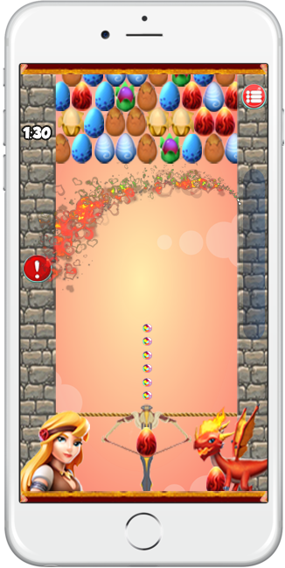
GAMEPLAY
Game subject (Trash and power bar)
Trash attack occurs when the power bar is full
When that happen, the power bar is depleted and a projectile will fly into the opponent button.
On opponent side, 5 random colors egg will added to the field, on the first eggs row in the bottom at random location.
Keep sending trash attack to stack up the eggs in the opponent field and end the game.

Slide 11
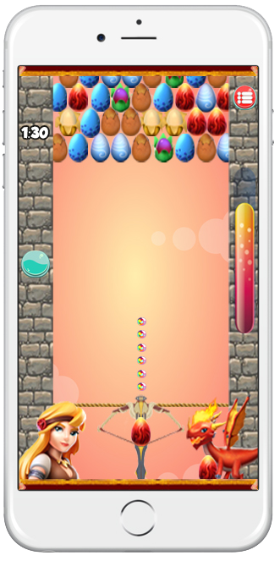
GAMEPLAY
Menu button
Gameplay screen
Egg field
Timer
Opponent state
Power bar
Aim path
MC
Touch zone
Next egg

Slide 12
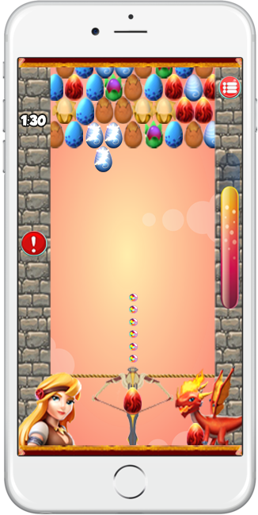
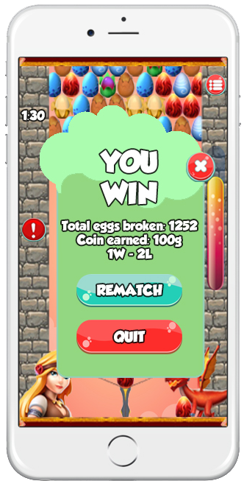
GAMEPLAY
Eggs break &
power gained
Full power will send
trash attack
You win when enemy
field reach deadline

Slide 13
Gameplay loop
Equip
dragons
Unlock
dragons
Earn coin
Play
Victory
Defeat
Single mode
Online mode
Player 1
Player 2
Start gameplay

Slide 14
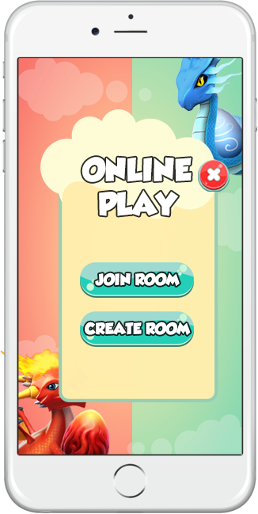
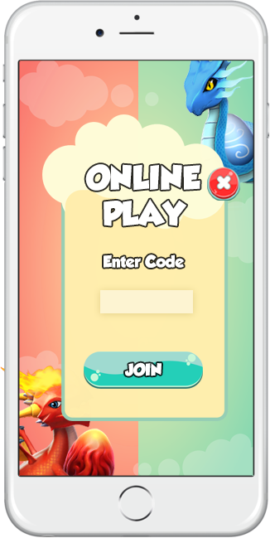
ONLINE FEATURE
Game feature
Game will offer PvP in real-time for 2 players.
Player will use a room-code system to match make.
In multiplayer menu:
Create room: will generate a room code to share to other player.
Join room: player can type in the room code to access the room.

Slide 15
FLOW
Main Menu
Mutual
agree
Yes
No
Setting
Option
Play
Shop
Yes
Rematch
No
Single mode
Online mode
Victory
Defeat
Dragon select
Skip
tutorial
Tutorial
Yes
Gameplay
No
Play tutorial

Slide 16
ONLINE FLOW
Create room
Generate
room code
Main Menu
Play
Online mode
Join
room
Input
room code
No
Rematch
Result
Action
phase
Waiting for
Player
In room
No
Yes
Yes
Mutual
agree

Slide 17
ADS FLOW
No more ads
Shop
Watch ads
Ads
Reward
No ads
Rewatch
Close menu

Slide 18
SHOP
Content
The shop will sell dragon skill according to elements.
Each skin is attribute to a tier, higher tier will be prettier and more expensive.
Skin serve as cosmetic and offer no gameplay advantages.
Ads
Player can watch ads to earn coin.
The number of ads player can watch per day is 3.
Each ad offer 10 coins.

Slide 19
COMBO METER
Combo | Percent fill in Combo meter
3 eggs | 5%
4 eggs | 7%
5 eggs | 10%
6 eggs | 14%
7 eggs | 19%
8 eggs | 25%
9 eggs | 32%
10+ eggs | 40%

Slide 20
COMBO METER VISUAL
% Gained | % Appear in bar
0% | 0%
1 – 10% | 10%
10 – 20% | 20%
20 – 30% | 30%
30 – 40% | 40%
40 – 50% | 50%
50 – 60% | 60%
60 – 70% | 70%
70 – 80% | 80%
80 – 90% | 90%
90 -100% | 100%

Slide 21
DIFFICULTY PROGRESION
Minute | Time interval | Total time minus
0 | 10 seconds | 0 second
2 | 9 seconds | 1 second
4 | 8 seconds | 2 seconds
6 | 7 seconds | 3 seconds
8 | 6 seconds | 4 seconds
10+ | 5 seconds | 5 seconds

Slide 22
REWARD SINGLEPLAYER
Number of eggs broken | Coin earned | Level | Bonus coin gain by level
200 | 10 Coin | 1 | 0 Coin
400 | 20 Coin | 2 | 20 Coin
600 | 30 Coin | 3 | 50 Coin
800 | 40 Coin | 4 | 90 Coin
1000 | 50 Coin | 5 | 140 Coin
1200+ | 60+ Coin | 6 | 220 Coin

Slide 23
REWARD MULTIPLAYER
Winning
Number of Win | Coin earned | Coin bonus by rank | Total Coin bonus (from 1st win)
1 | 30 Coin | 0 Coin | 0 Coin
2 | 50 Coin | 20 Coin | 20 Coin
3 | 80 Coin | 30 Coin | 50 Coin
4 | 120 Coin | 40 Coin | 90 Coin
5 | 170 Coin | 50 Coin | 140 Coin
6+ | 250 Coin | 80 Coin | 220 Coin
Losing
Losing is granted 5 Coin as compensation, regardless of streak. Reset winstreak.

Slide 24
THANK YOU

